Slide 1
반제품 제작을 위한 LTE 통신 모듈 스펙 정리
jefflee@ocube.co.kr

Slide 2
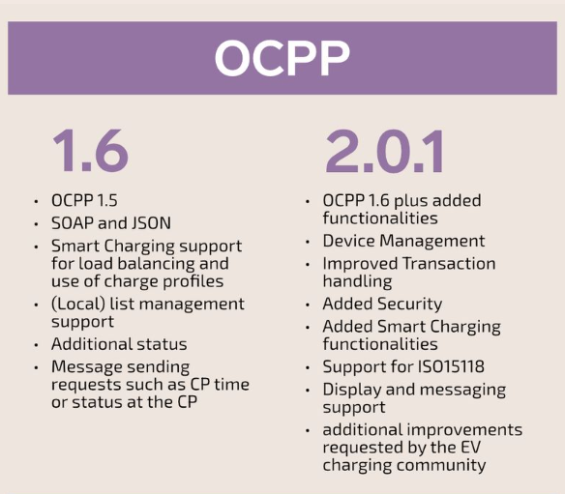
OCPP 1.6 ~ 2.x
OCPP 1.6 지원 스펙
Flash Memory : 1MB 이하
DDR Memory : 512KB 이하
암호화 스펙 : TLS 1.2(SSL)
바이너리 사이즈 : 200KB~ ( 예상, 현재 170KB )
OCPP 2.x 지원 스펙
Flash Memory : 1MB 이상 ~ 2MB 예상
DDR Memory : 1MB 이상
암호화 스펙 : TLS 1.2 (SSL)
바이너리 사이즈 : 500KB~ 700KB
*1.6에서 2.x 업그레이드시 평균적으로 4배 이상 용량 예상

Slide 3
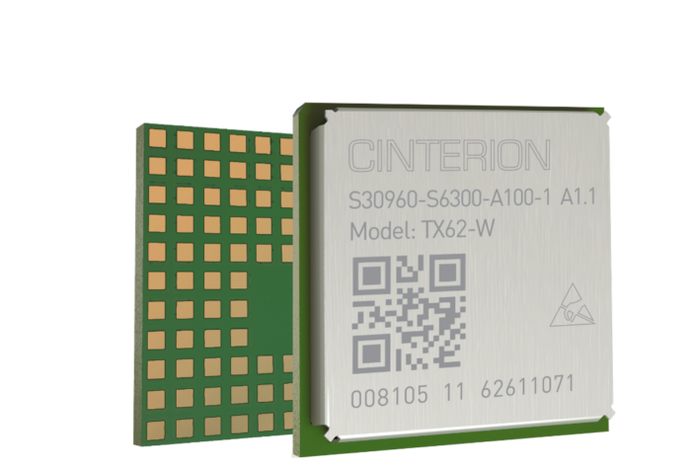
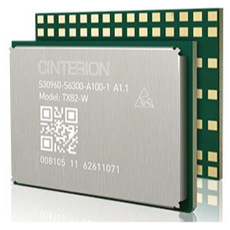
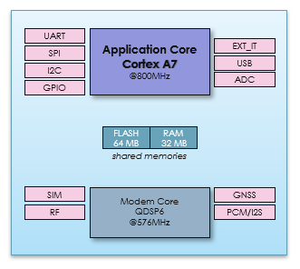
Telit 모듈 스펙
구 Thales TX62-WB/82-W (ThreadX)
AP : MDM9205 ( ARM Cortex-A7 AP at 800MHz )
GSM : TX82 only
Flash Memory : 64MB ( 1MB Custom App )
DDR Memory : 32MB ( 512KB Custom App )
Speed Category : CatM1 / NBIoT
Up/Down Speed : 375kbps / 375kbps
OS : ThreadX ( Embedded RTOS )
API : QAPI , GINA
SW Platform : IoT SDK
Protocol : TCP/IP (SSL/TLS 1.2~3 지원), HTTP(S), FTP

Slide 4
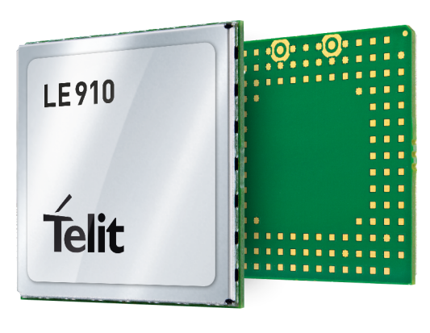
Telit 모듈 스펙
LE910Cx WWX (ThreadX)
AP : MDM9207 ( ARM Cortex-A7 AP at 1.2 GHz )
Flash Memory : 128MB ( 7MB Custom App )
DDR Memory : 128MB ( 16MB Custom App )
Speed Category : LTE Cat1, Cat4 ( C4 model )
Up/Down Speed : 5Mbps / 10Mbps, 50Mbps/ 150Mbps
OS : ThreadX
API : QAPI
SDK : AppZone
Protocol : TCP/IP(SSL/TLS 지원), FTP, HTTP(S), SMS

Slide 5
Telit 모듈 스펙
LE910Cx LE (Linux Enabled)
AP : MDM9207 ( ARM Cortex-A7 AP at 1.2 GHz )
Flash Memory : 256MB ~ 512MB ( 100MB ~ 170MB )
DDR Memory : 128MB ~ 256MB ( 16MB Custom App )
Speed Category : LTE Cat1, Cat4 ( C4 model )
Up/Down Speed : 5Mbps / 10Mbps, 50Mbps/ 150Mbps
OS : Linux
API : QAPI
SDK : AppZone
Protocol : TCP/IP(SSL/TLS 지원), FTP, HTTP(S), SMS

Slide 6
스펙 비교
 | LTE Cat | Flash Size | Memory Size
TXx2
LE910 ThreadX
LE910 Linux

Slide 7
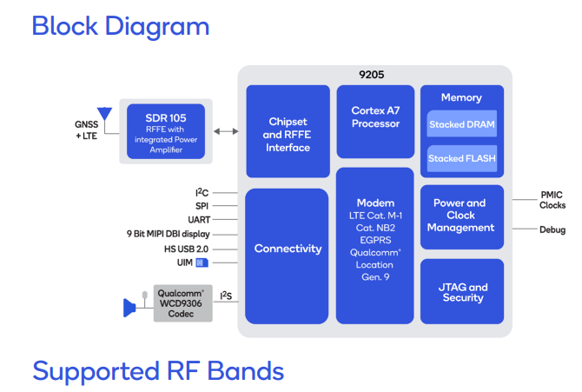
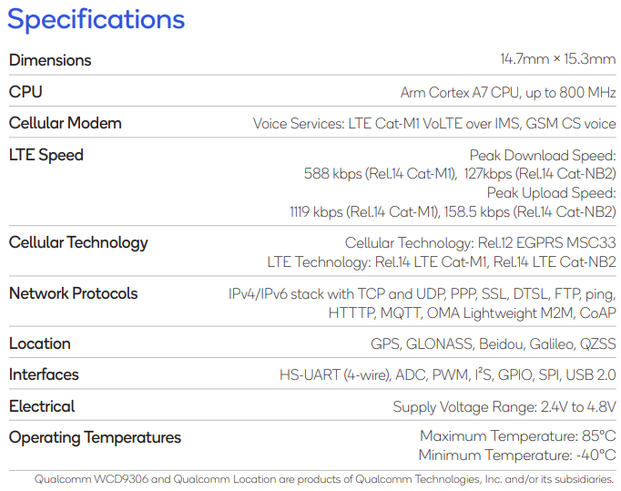
Qualcomm MDM9205
Notes:
https://www.qualcomm.com/content/dam/qcomm-martech/dm-assets/documents/9205-lte-modem-product-brief_87-pw321-1.pdf
Features Advanced Rel.14 LTE capabilities: Cat-M1 with 2,984 max. UL TBS Rel.14, Cat-M1 VoLTE enhancements, Cat-NB2 with multi-carrier NPRACH and Paging, Cat-M1 coverage enhancements Mode A support, Cat-M1 with enhanced coverage restriction, Cat-M1 w/ HARQ-ACK bundling in HD-FDD mode, CatNB2 with larger TBS and 2 HARQ processes, Cat-M1 retuning to another narrowband region within 1 retuning symbol, Cat-NB2 Release Assistance Indication (RAI) Voice Services: LTE Cat-M1 VoLTE over IMS, GSM CS voice Security Features: Secure debug, Hardwarebased Crypto Engine, Secure file system, Qualcomm Trusted Execution Environment, Secure Boot Battery thermal monitoring capability Integrated Cortex A7 processor supports ThreadX and AliOS Things RTOS One hardware design supporting eMTC/ Cat-M1, NB-IoT/Cat-NB2, E-GPRS One software image no matter what technology is used One RF: Extended frequency range support from 450MHz to 2.1GHz supporting >23 global bands Power optimized, turnkey industrial tracker reference design, with integrated indoor and outdoor position location capabilities, and integrated drivers for various sensors. Companion antenna tuner and reference antenna solution for cellular and GNSS bring the ease of addressing global connectivity with a single hardware solution.
Software Operating Systems: ThreadX OS LTE IoT Software Development Kit: Designed to support developers in running custom software on the integrated applications processor, as well as to provide them access to additional capabilities of the Qualcomm 9205 LTE modem, such as geolocation. The SDK offers pre-integrated support for many cloud platforms, including Microosoft Azure, Alibaba Cloud Link One, China Mobile OneNET, DTSTON DTCloud, Ericsson IoT Accelerator, Gizwits and Verizon ThingSpace, and it also allows developers to extend this integration further and develop support for other major IoT cloud providers.

Slide 8

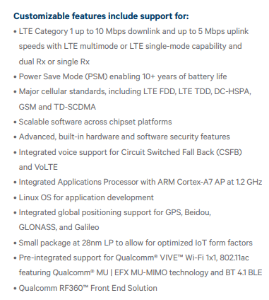
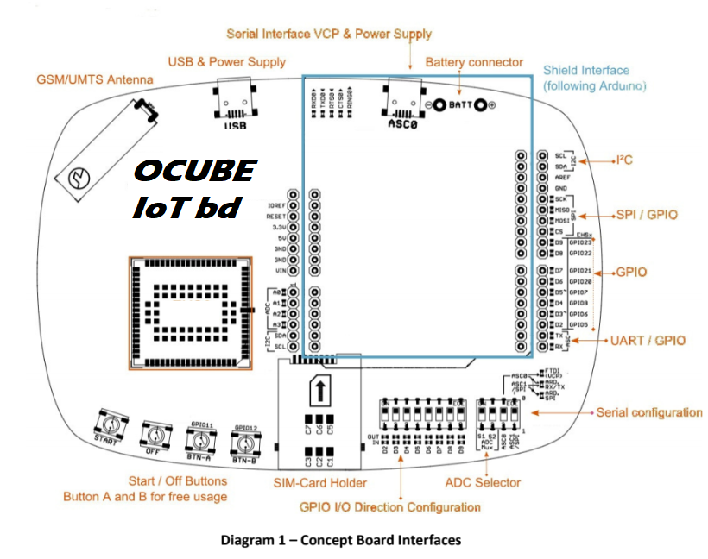
Qualcomm MDM9207
Notes:
https://www.qualcomm.com/content/dam/qcomm-martech/dm-assets/documents/qualcomm_3g-4g_lte_iot_infographic_final.pdf
https://www.telit.com/press/telit-lte-iot-modules-portfolio-adds-global-skus/

Slide 9
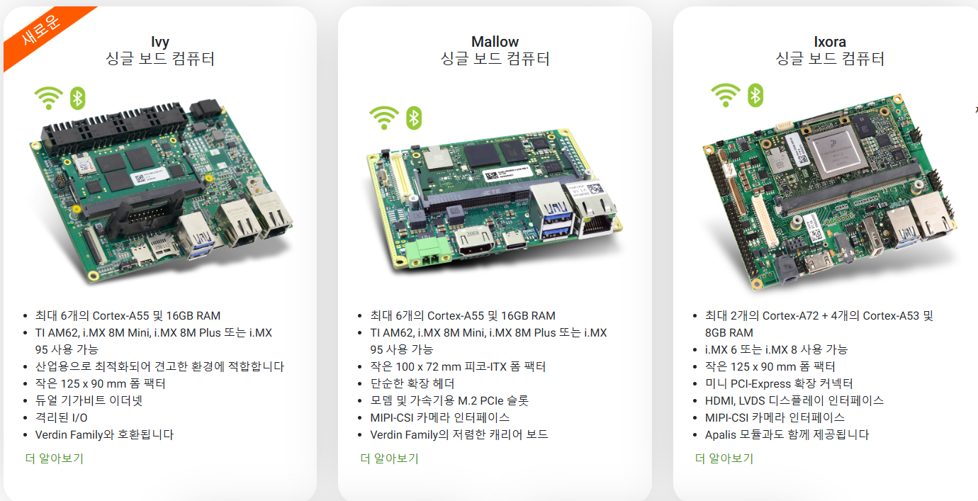

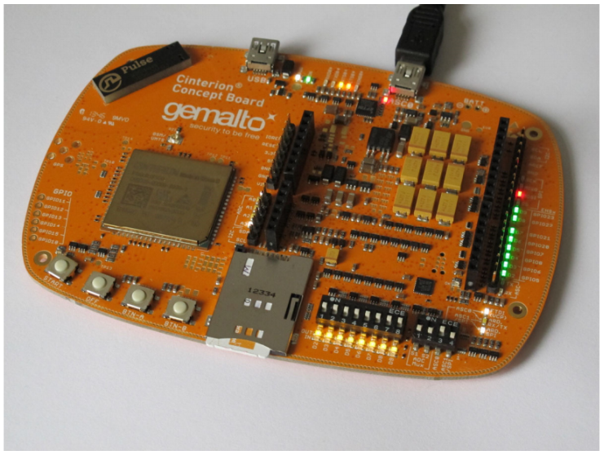
반제품 보드
제안 #1: EV 환경 구축
[ 전기차 충전 솔루션 대응 ]
MCU + TX62-WB => OCPP 1.6J
SBC CPU + LE910Cx => OCPP 2.x
제안 #2: IoT 사물 인터넷 응용
[ Asset Tracker ]
Stand Alone Module Based
TX82 *현성 진행중
제안 #3: 그리드 솔루션
[ Smart Metering ]
TX62-WB Module Solution ( GSM )
Stand Alone IoT 컨셉 보드
Single Board Computer
+ LTE 모듈

